Slide 1
Backend 101
presentation by Charlton

Slide 2


Java/Kotlin
Swift
React Native
Main Purpose of Server
get/manipulate data from somewhere
do some expensive computation
Mobile Apps
Elasticsearch
MongoDB
MySQL
PostgreSQL
SQLite
Redis
ExpressJS
Flask
Laravel Spring Boot
Ruby on Rails
AngularJS
ReactJS
+ HTML/CSS
Websites
Server
Database
Frontend
Backend

Slide 3
Getting started with FLASK
a step-by-step walkthrough

Slide 4
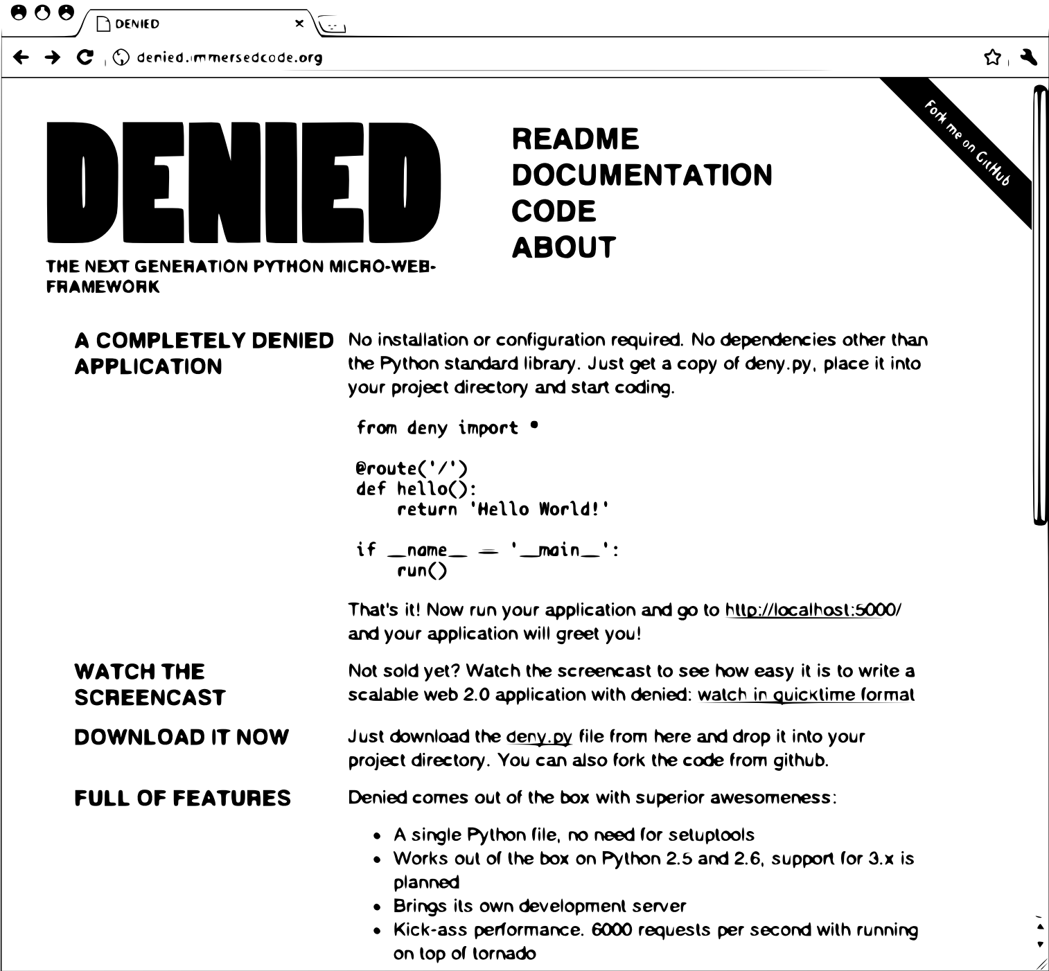
Brief history about FLASK
created by Armin Ronacher in 2010
originally called Denied
was meant as an April Fool’s joke
Full story here!

Slide 5
2 ways of following this tutorial:
via repl.it/languages/python3
OR
locally via command line + your fav text editor
Note: also download Postman to test your server
Click here to flip a coin if you can’t decide!

Slide 6

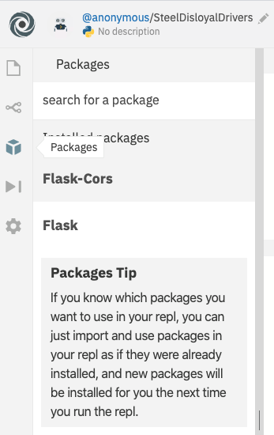
Project Structure
flask_tutorial
├── project_venv
├── main.py
├── requirements.txt
> mkdir flask_tutorial
> cd flask_tutorial
> touch main.py
Installation
> python3 -m venv project_venv
> source project_venv/bin/activate
> pip install flask
> pip install flask-cors
> pip install sqlalchemy
> pip freeze > requirements.txt
OR

Slide 7

from flask import Flask
from flask_cors import CORS
app = Flask(__name__)
CORS(app)
@app.route('/hello')
def hello():
return 'hello from the other side.'
if __name__ == '__main__':
app.run(host='127.0.0.1', port=8080, threaded=True)
import 3rd party module
creates a global app object
defines a '/hello' route
entrypoint for Flask application
change to host='0.0.0.0' if on Repl
main.py
> python3 main.py

Slide 8
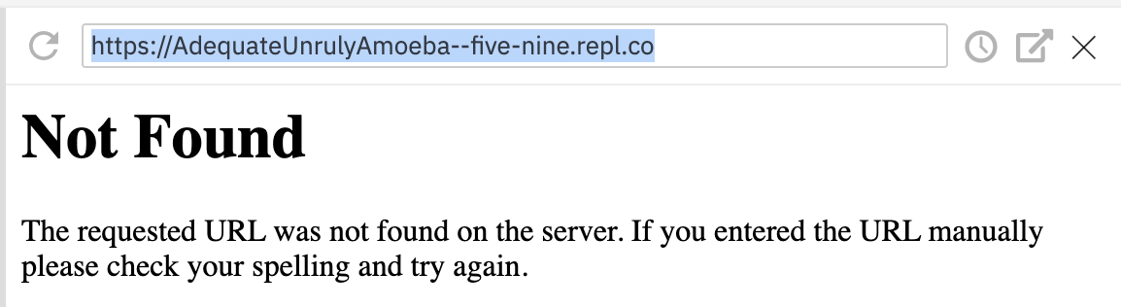
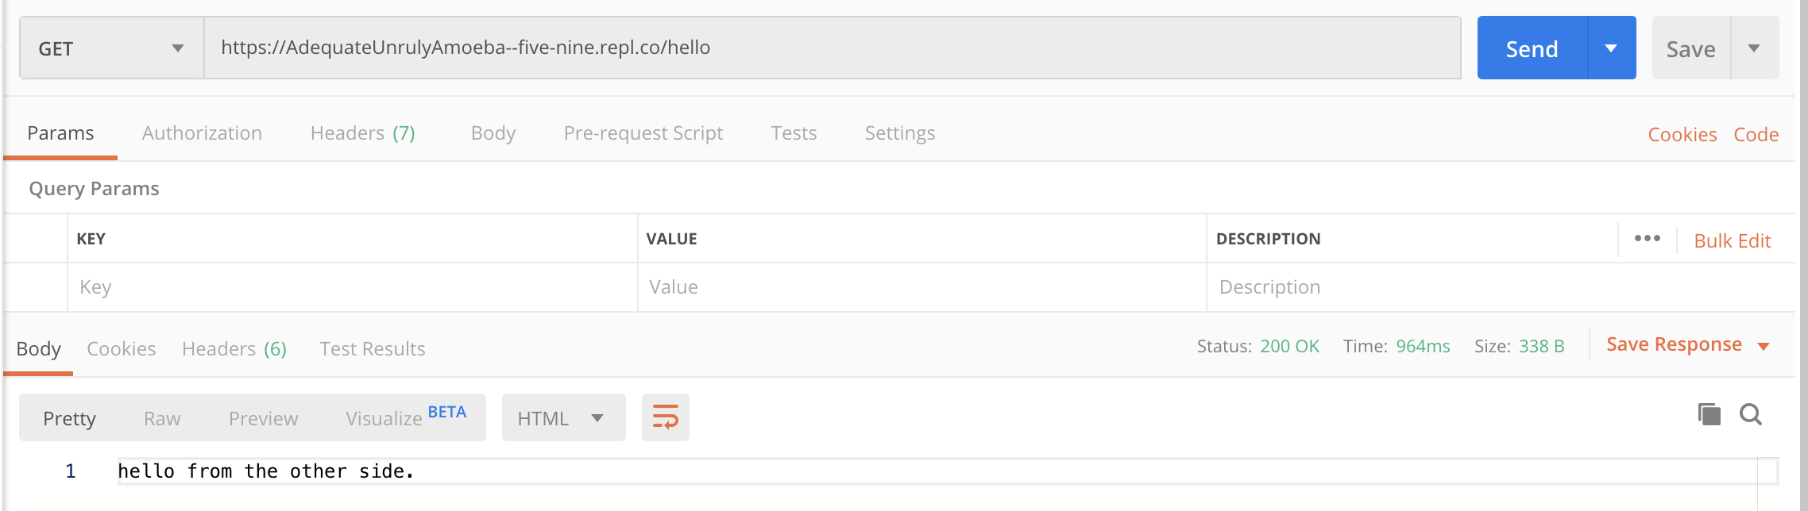
Note: if running locally, use http://localhost:8080/hello instead
copy & paste this link in Postman and add '/hello' at the end . Hit Send.

Slide 9
Congrats! You are now a fully fledged backend engineer. it is time to embark on a real world project...

Slide 10

Real World Project
Client: Mary
Scenario: Due to an unforeseen population explosion, Mary now finds it tough to manage her 1000+ lambs! Not only do they look alike, each of them has their own set of unique characteristics which she has to tend to on an individual basis. She would like a Lamb Management System, which keeps track of their personal particulars. She would also like to add and remove lambs from the system, as well as to update their personal information.

Slide 11

What are Relational Databases?
magic
magic
think of them as magically-linked spreadsheets!
Relational Databases requires a special language called Structured Query Language (SQL) to interact with it.
SELECT DISTINCT salary
FROM employee a
WHERE 3 >= (SELECT Count(DISTINCT salary)
FROM employee b
WHERE a.salary <= b.salary)
ORDER BY a.salary DESC;
in layman terms
get the 3 highest paid employees from Employee table

Slide 12

Fact: no one likes SQL
Thankfully, SQLAlchemy help us convert Python code to SQL behind the scenes!

Slide 13
Updated Project Structure
flask_tutorial
├── project_venv
├── main.py
├── database.py
├── schema.py
├── lambs.db
├── requirements.txt
> touch schema.py
> touch database.py
> touch lambs.db

Slide 14
from sqlalchemy.ext.declarative import declarative_base
from sqlalchemy import Column, String, Float, Integer
class DietaryType:
NORMAL = 'NORMAL'
GLUTEN_FREE = 'GLUTEN_FREE'
SOY_ALLERGY = 'SOY_ALLERGY'
PEANUT_ALLERGY = 'PEANUT_ALLERGY'
Base = declarative_base()
class Lamb(Base):
__tablename__ = 'lamb'
id = Column(Integer, primary_key=True)
name = Column(String, unique=True, nullable=False)
weight = Column(Float, nullable=False)
dietary_type = Column(String, nullable=False, default=DietaryType.NORMAL)
id | name | weight | dietary_type
1 | Joe | 37.2 | NORMAL
schema.py

Slide 15
from sqlalchemy import create_engine
from sqlalchemy.orm import sessionmaker
from schema import Base, Lamb, DietaryType
class Database:
def __init__(self, filename):
connection_url = 'sqlite:///{}'.format(filename)
self._engine = create_engine(connection_url)
self._Session = sessionmaker(bind=self._engine)
self._session = None
self._define_tables()
def _define_tables(self):
Base.metadata.create_all(bind=self._engine)
database.py (Part 1/4)

Slide 16

def commit(self):
self._session.commit()
def connect(self):
self._session = self._Session()
def disconnect(self):
if self._session:
self._session.commit()
self._session.close()
self._session = None
def __enter__(self):
self.connect()
def __exit__(self, exception_type, exception_value, traceback):
self.disconnect()
database.py (Part 2/4)

Slide 17
Usage
What happens when u forget to call disconnect()?
db.connect()
db.do_something()
db.disconnect()
Using Python with command
db.__enter__()
with db:
db.do_something()
do_something_else()
db.__exit__()

Slide 18
def create_lamb(self, name, weight, dietary_type):
lamb = Lamb(
name=name,
weight=weight,
dietary_type=dietary_type
)
self._session.add(lamb)
return lamb
def get_lamb(self, id):
lamb = self._session.query(Lamb).get(id)
return lamb
database.py (Part 3/4)

Slide 19
def update_lamb(self, id, name, weight, dietary_type):
lamb = self.get_lamb(id)
lamb.name = name
lamb.weight = weight
lamb.dietary_type = dietary_type
self._session.add(lamb)
return lamb
def delete_lamb(self, id):
lamb = self.get_lamb(id)
self._session.delete(lamb)
return lamb
database.py (Part 4/4)

Slide 20
HTTP Methods
Spreadsheet Analogy
GET
give me one or more rows
POST
insert a new row
PUT
update values of row
DELETE
delete row

Slide 21
from flask import Flask, jsonify, request
from flask_cors import CORS
from database import Database
app = Flask(__name__)
CORS(app)
db = Database('lamb.db')
@app.route('/lambs', methods=['POST'])
def create_lamb():
params = get_request_params()
with db:
lamb = db.create_lamb(**params)
db.commit()
response = {'id': lamb.id, 'name': lamb.name, 'weight': lamb.weight, 'dietary_type': lamb.dietary_type}
return jsonify(response)
main.py Part(1/3)

Slide 22
@app.route('/lambs/<id>', methods=['GET','PUT','DELETE'])
def get_put_delete_lamb(id):
with db:
if request.method == 'GET':
lamb = db.get_lamb(id)
elif request.method == 'PUT':
params = get_request_params()
lamb = db.update_lamb(id, **params)
db.commit()
elif request.method == 'DELETE':
lamb = db.delete_lamb(id)
db.commit()
response = {'id': lamb.id, 'name': lamb.name, 'weight': lamb.weight, 'dietary_type': lamb.dietary_type}
return jsonify(response)
main.py Part(2/3)

Slide 23
def get_request_params():
params = request.get_json()
if not params:
params = request.form.to_dict()
query_params = {k: v for k, v in request.args.items()}
params = {**params, **query_params}
return params
if __name__ == '__main__':
app.run(host='127.0.0.1', port=8080, threaded=True)
rmb to change to host='0.0.0.0' if on Repl
main.py Part(3/3)

Slide 24
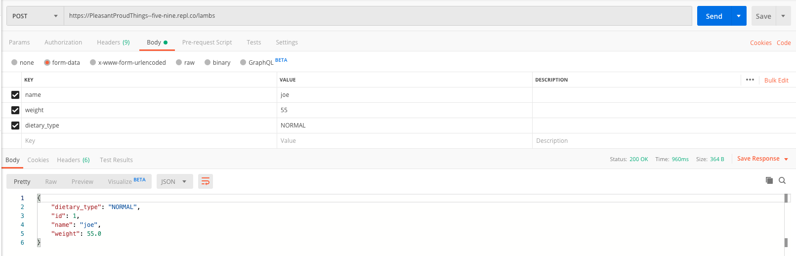
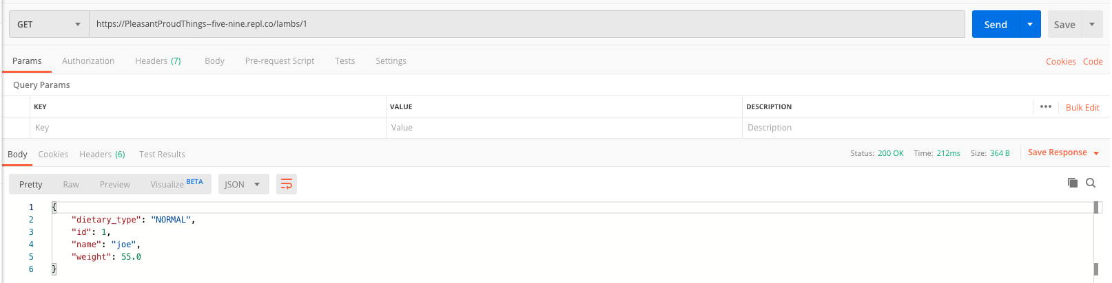

Slide 25
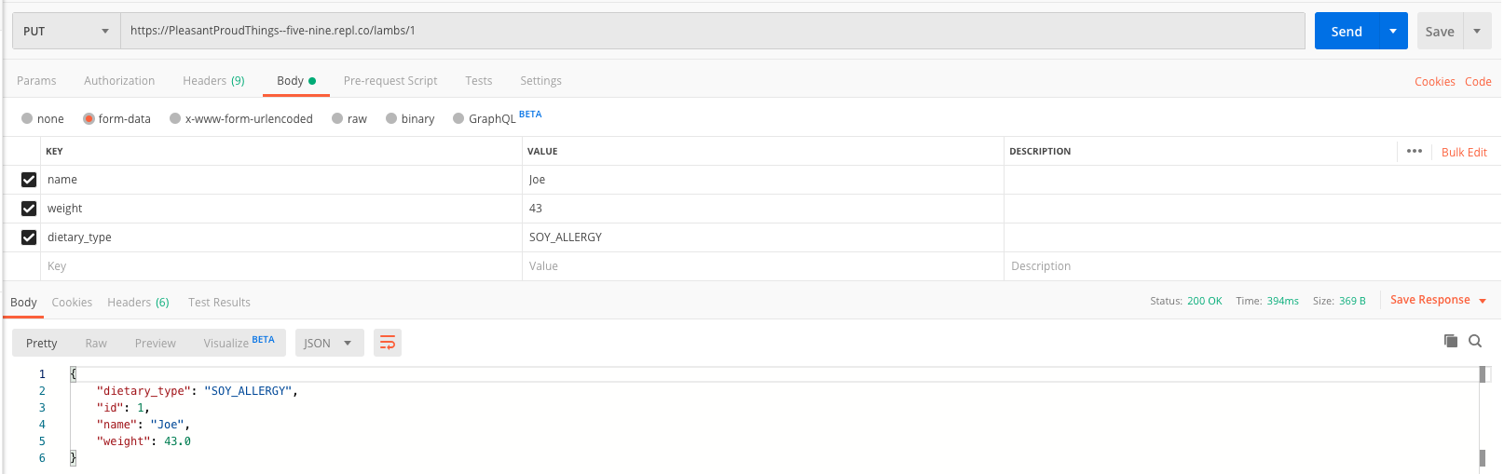
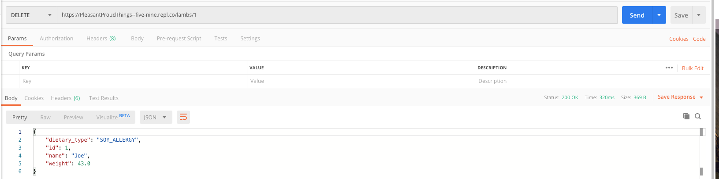

Slide 26
Thank You!
full code can be found here!

